Slide 1
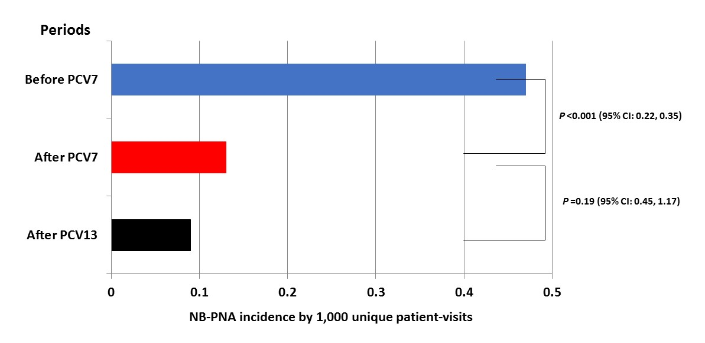
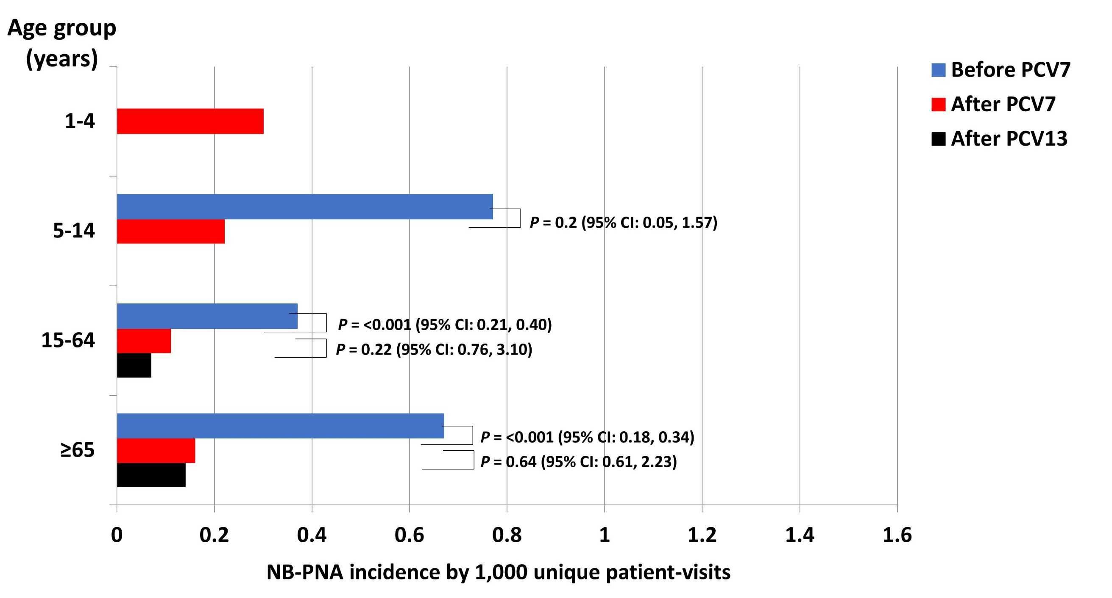
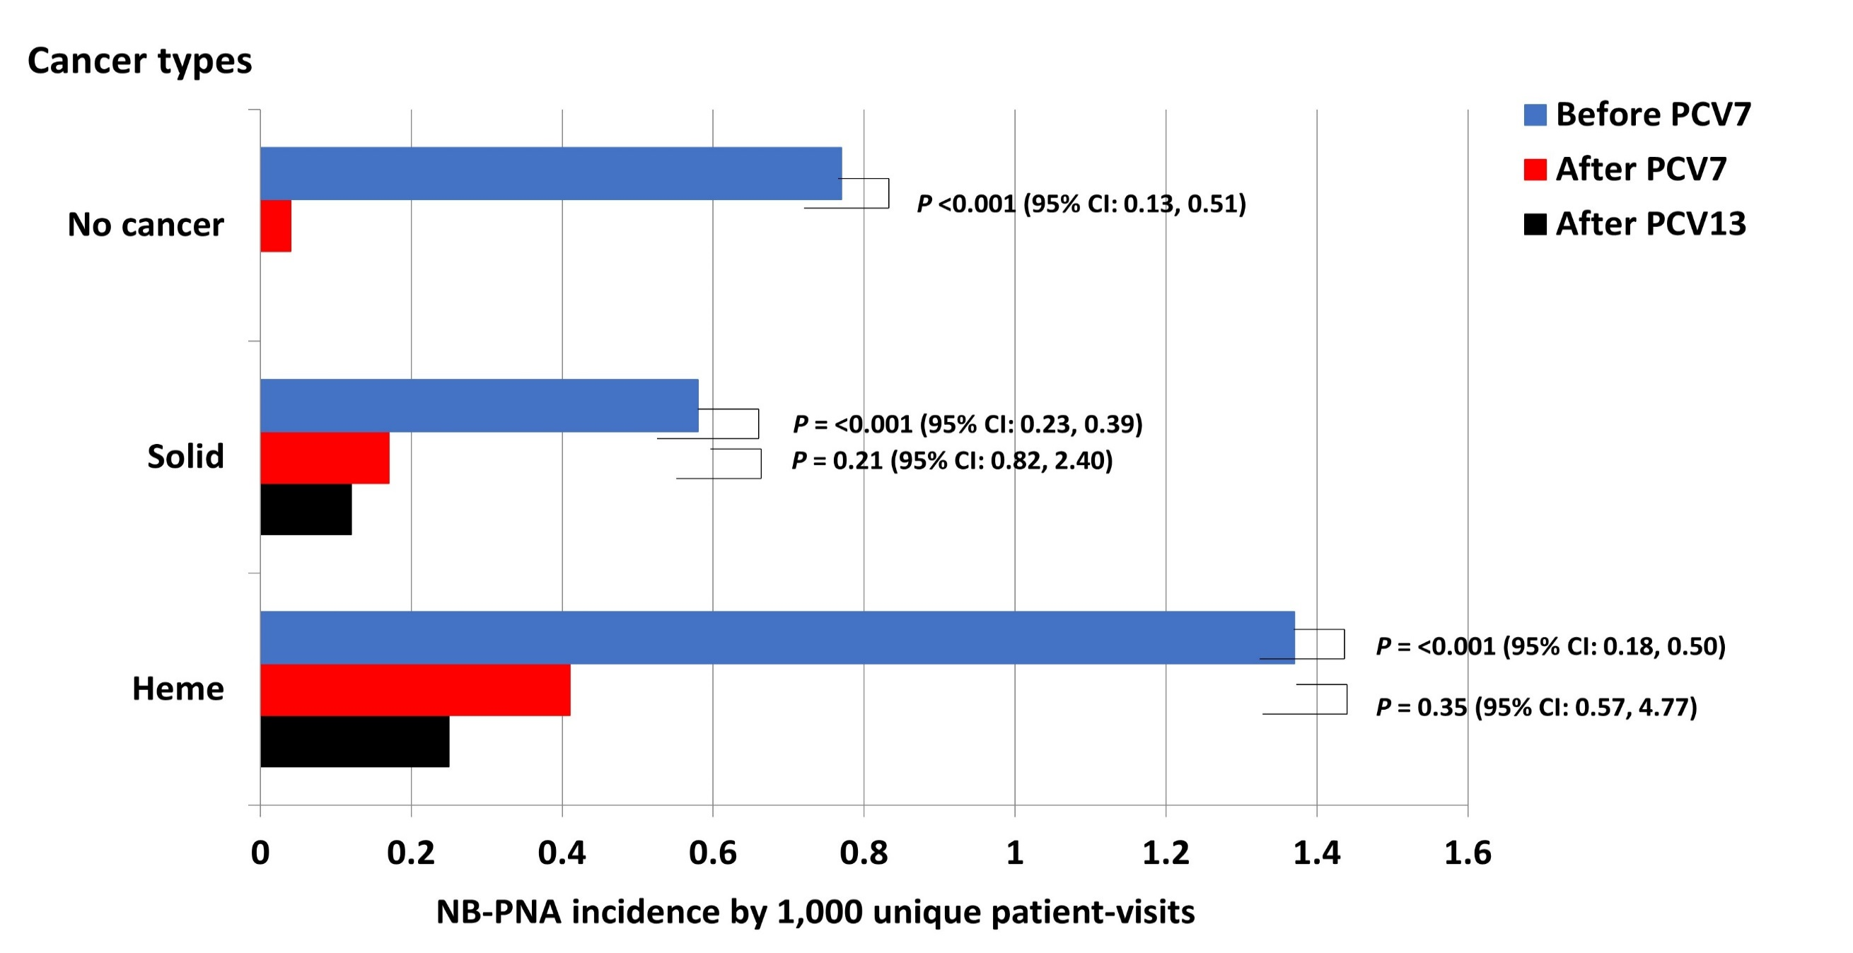
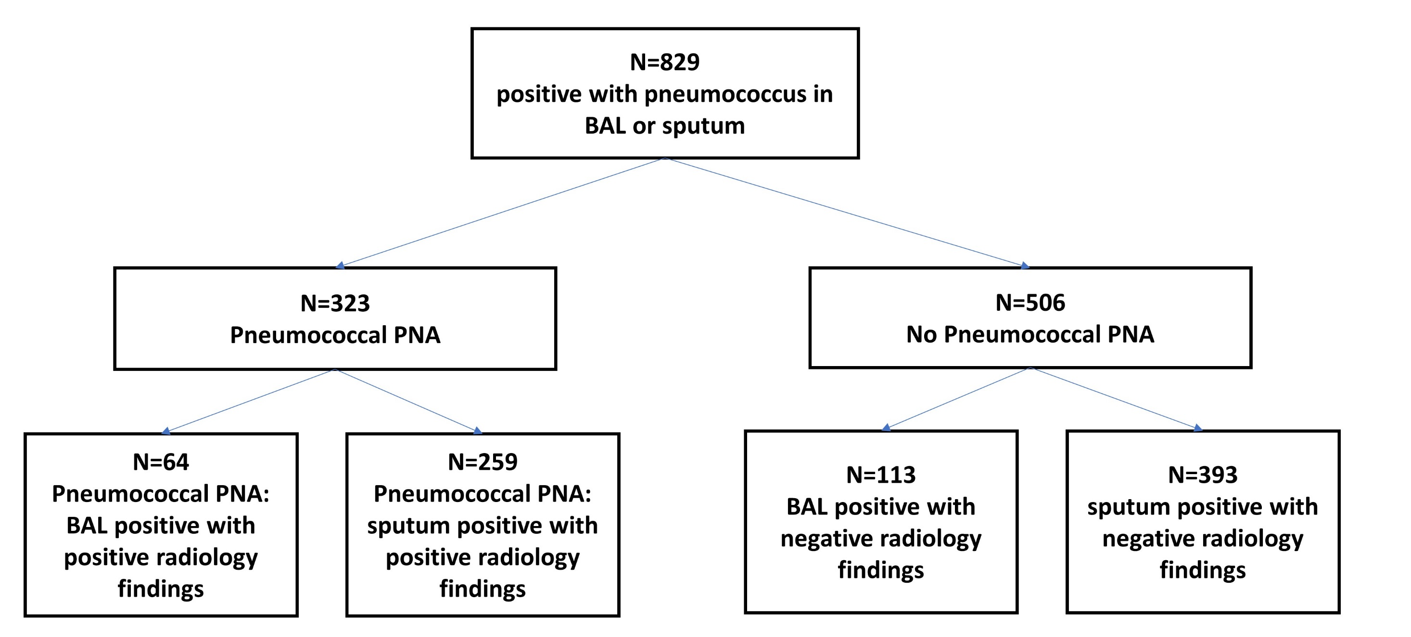
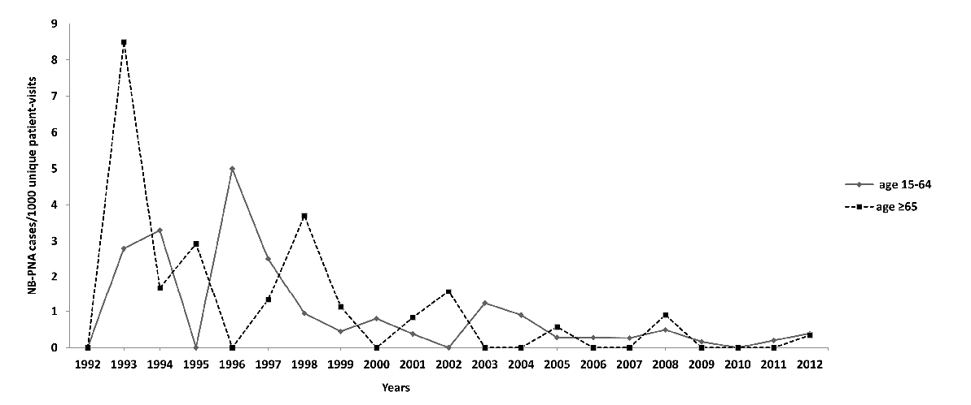
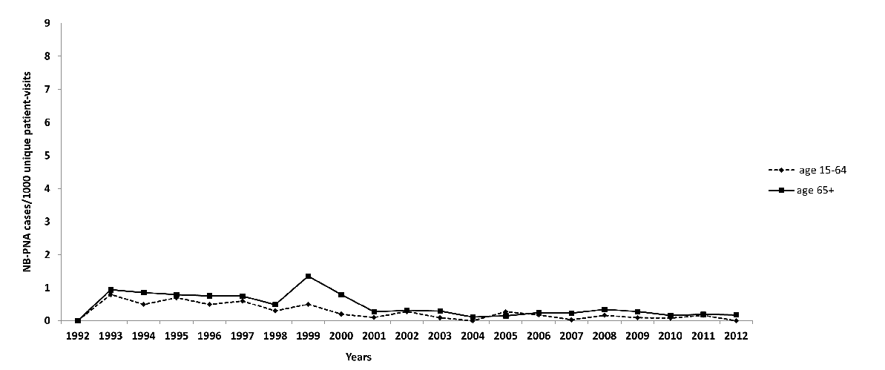
The impact of pneumococcal conjugate vaccine in nonbacteremic pneumococcal pneumonia among cancer patients
Yeon Joo Lee, MD, MPH^{1, 3}, Rocco Richards, MD², Yiqi Su, MS¹, Anna Kaltsas, MD, MS^{1, 3}, Genovefa Papanicolaou, MD^{1, 3}
Poster number: 2717
¹Infectious Diseases Service, Department of Medicine, Memorial Sloan Kettering Cancer Center, New York, NY, ²Division of Infectious Diseases, New York Medical College at Westchester Medical Center, Valhalla, NY, ³Weill Cornell Medical College, Cornell University, New York, NY
Introduction
Incidence of PNA (#cases per 1,000 UPV)
Conclusions
Invasive pneumococcal disease (IPD) and non-bacteremic pneumococcal pneumonia (NB-PNA) are associated with substantial morbidity and mortality in cancer patients.
We have previously reported a decline in the incidence of IPD in cancer patients treated at MSKCC after the introduction of routine childhood immunization with the 7-valent pneumococcal conjugate vaccine (PCV7) into the community.
We compared the incidence of NB-PNA in cancer patients treated at MSKCC before and after the introduction of PCV7.
The incidence of NB-PNA in adult cancer patients declined after PCV7 compared to before the introduction of PCV7.
The reduction in NB-PNA was highest in patients ≥65 years suggesting an indirect effect from PCV7 childhood immunization.
A trend towards decreased incidence in NB-PNA was noted after PCV13; further surveillance is required to ascertain this trend.
Methods
Incidence of PNA by age and cancer types
Retrospective cohort study of patients treated at MSKCC from 1993 through 2002.
Unique patients visits (UPV) per year were defined as ≥1 inpatient or outpatient encounter within one calendar year.
Patients with respiratory cultures positive for S. pneumoniae specimens were identified from clinical microbiology records.
NB-PNA was defined as isolation of S. pneumoniae from sputum or bronchoalveolar lavage (BAL) with associated symptoms and radiographic findings compatible with pneumonia.
NB-PNA incidence was calculated as number of NB-PNA cases per 1000 UPV. Three time-periods were examined: “before PCV7” (1993-2000), “after PCV7” (2001-2010), “after PCV13” (2011-2012).
PNA incidence by age groups
PNA incidence by cancer types
Annual trends in the incidence of PNA in adult cancer patients
Adjudication of PNA cases
Hematologic malignancies 15 - ≥ 65 years
Solid tumors 15 - ≥ 65 years
Funding source
Corresponding author: Yeon Joo (June) Lee
leey3@mskcc.org
1275 York Ave, Box 9, New York, NY 10065
Funded in part through the NIH/NCI Cancer Center Support Grant P30 CA008748.
Of 323 NB-PNA cases, S. pneumoniae was isolated from BAL in 64 (20%) and sputum in 259 (80%).

